Slide 1

Implementation of Quantum-based Random Number Generator for Cryptographic Applications
Chennamsetty Veda Vardhan-124160059
Lagisetty Sai Rishitha-124160091
Kankatala Saranya-124160026
ECE(CPS)/SEEE
Guide
Prof. C.Manikandan
AP-III
ECE/SEEE
SASTRA Deemed University
Thanjavur

Slide 2
PRESENTATION OUTLINE
Problem Statement
Objective
Literature Survey
Proposed Methodology
Implementation of Methodology
Result and Discussions
Time Line Activity
References

Slide 3
PROBLEM STATEMENT
Generally, Linear Feedback Shift Register based Random Number Generators are used for generating the keys. Due to limitations like pre-defined algorithm, high power dissipation and low operating speed in CMOS-based architectures. Linear Feedback Shift Registers are designed using Quantum-dot cellular automata (QCA) Architecture. QCA is a one of the quantum circuit design, has superior performance compared to CMOS in most performance areas, such as space, speed and power.

Slide 4
OBJECTIVE
To design a quantum-based Linear Feedback Shift Register for cryptographic applications and analyze its performance using the QCA Pro tool.

Slide 5
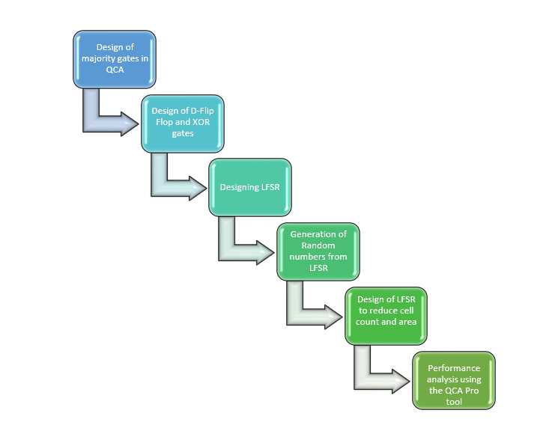
PROPOSED METHODOLOGY

Slide 6
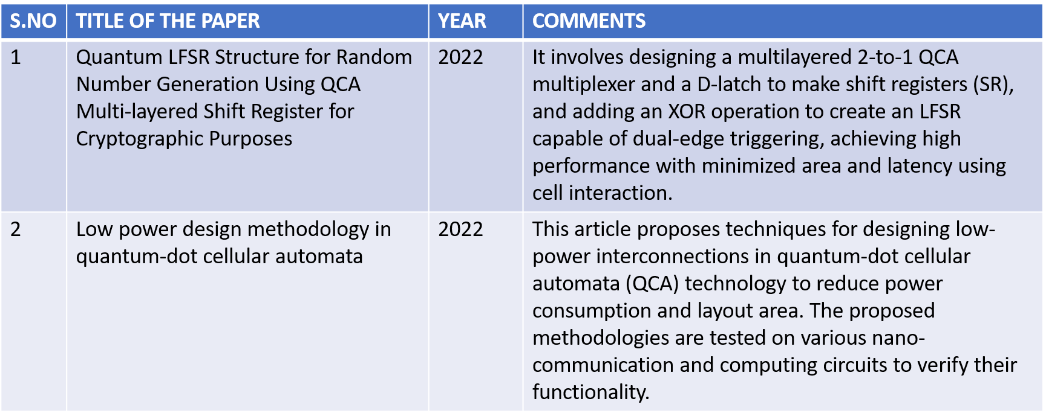
LITERATURE SURVEY

Slide 7
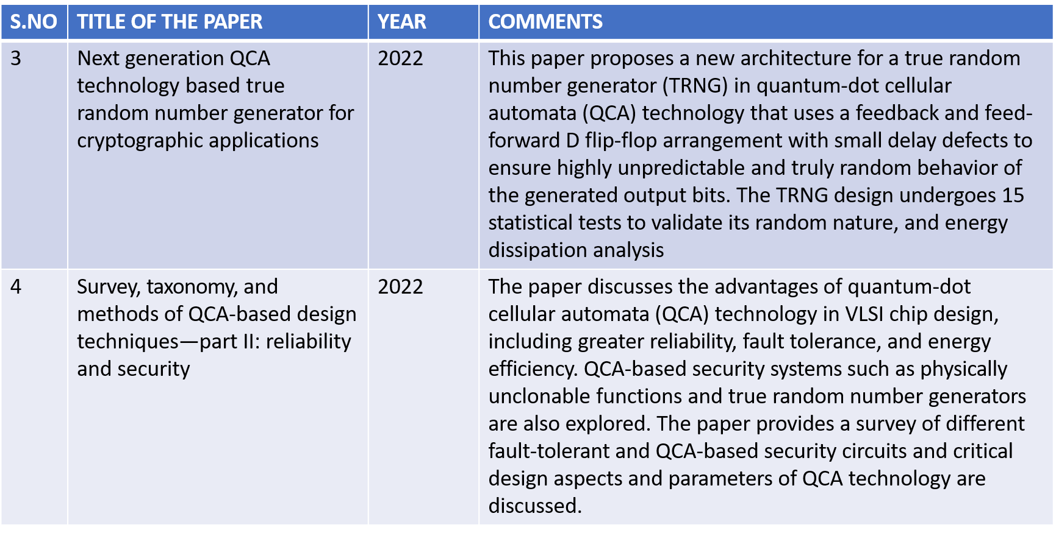

Slide 8
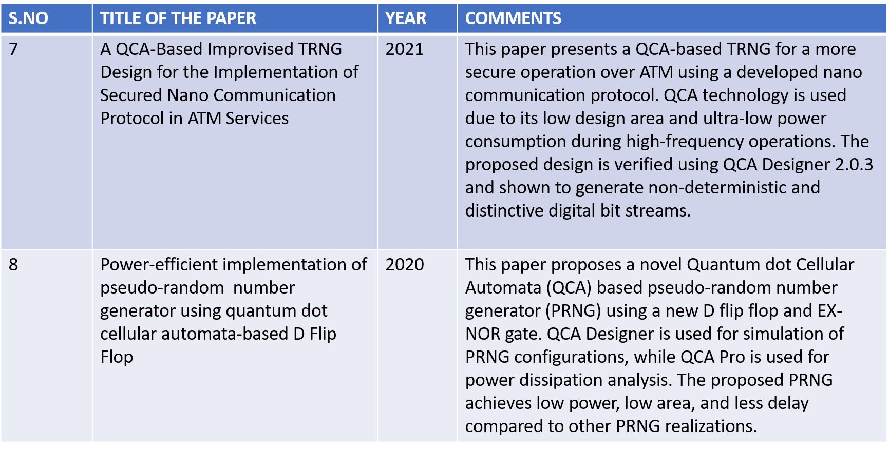

Slide 9
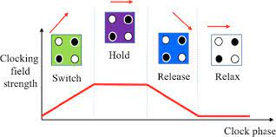
CLOCKING IN QCA
Gives direction of the flow of data
The four clock phases are
Switch
Hold
Release
Relax

Slide 10
IMPLEMENTATION OF METHODOLOGY

Slide 11
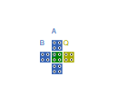
MAJORITY GATE
A | B | C | Y
0 | 0 | 0 | 0
0 | 0 | 1 | 0
0 | 1 | 0 | 0
0 | 1 | 1 | 1
1 | 0 | 0 | 0
1 | 0 | 1 | 1
1 | 1 | 0 | 1
1 | 1 | 1 | 1
MAJORITY GATE
TRUTH TABLE

Slide 12
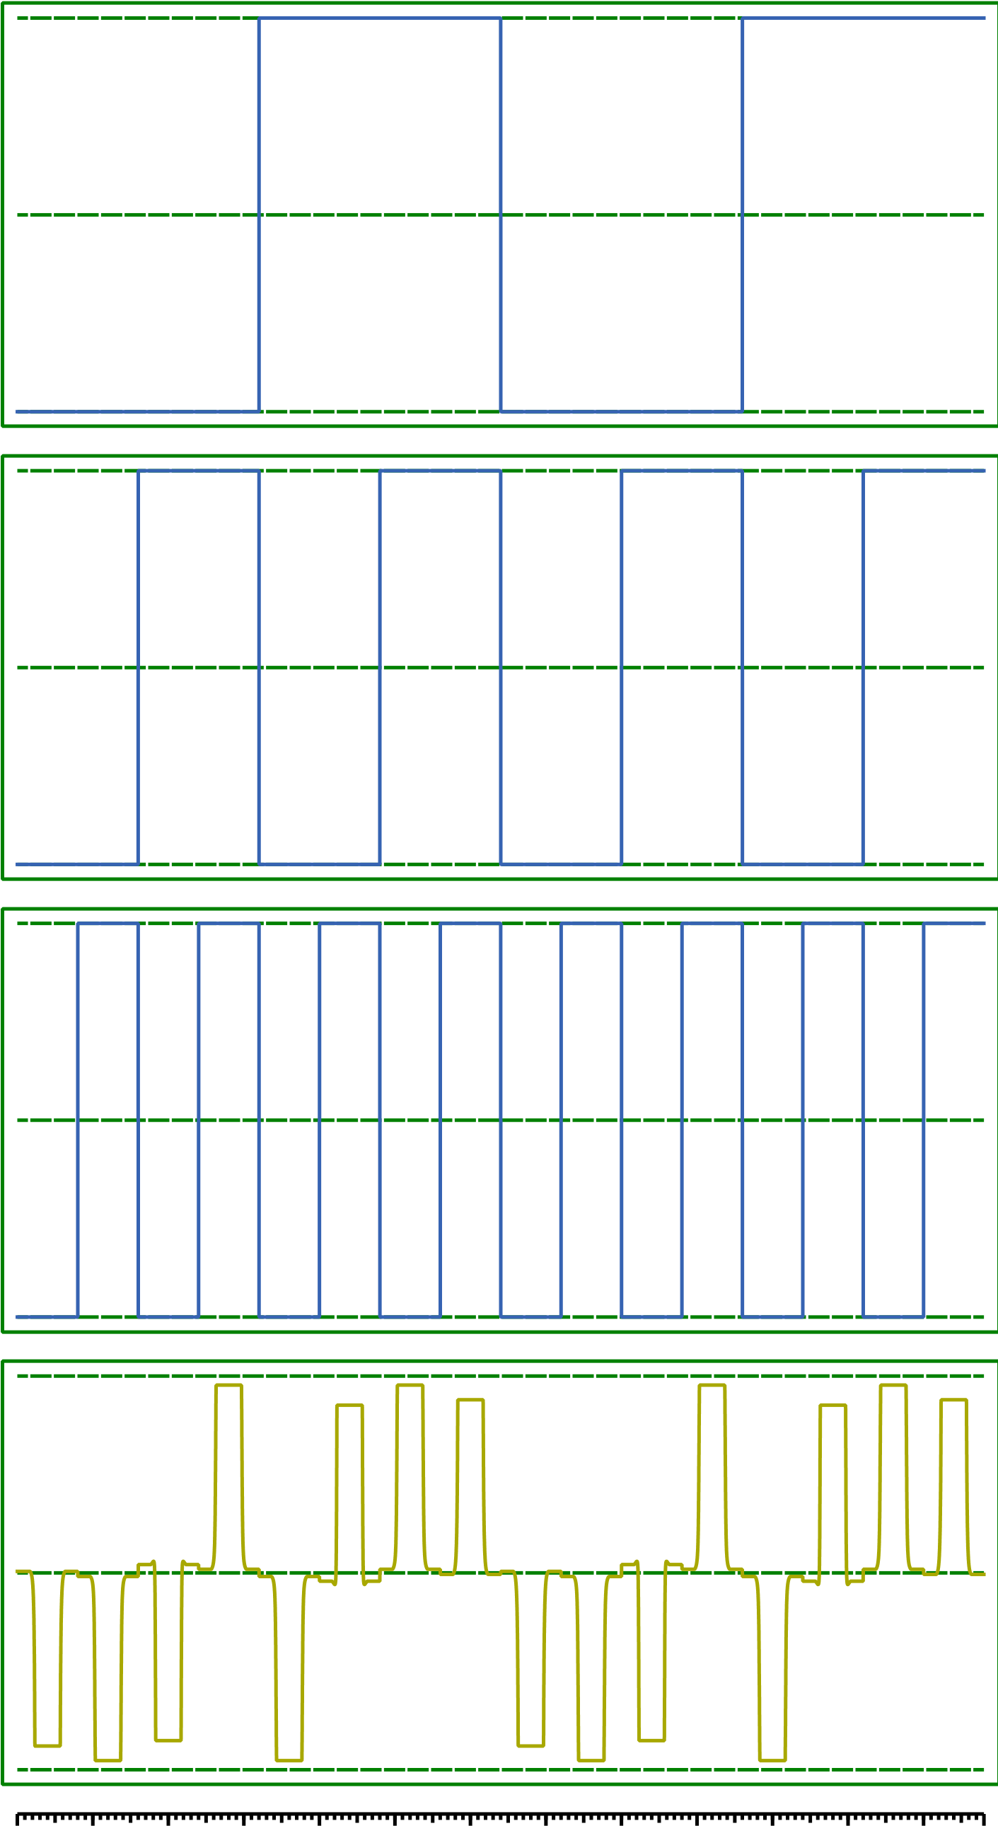
SIMULATION
AA
A
BB
B
C
C
C
Q

Slide 13
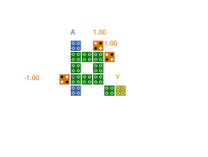
XOR GATE
A | B | Y
0 | 0 | 0
0 | 1 | 1
1 | 0 | 1
1 | 1 | 0
TRUTH TABLE

Slide 14
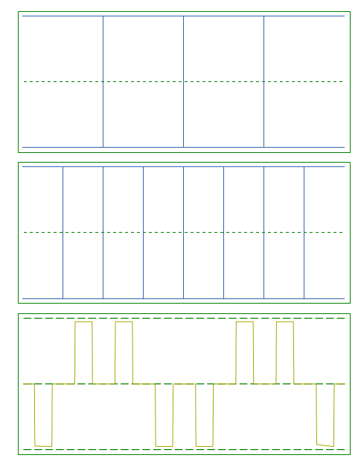
SIMULATION
A
B
Q

Slide 15
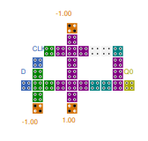
D-FLIPFLOP
CLOCK | D | Q
0 | 0 | Q(n-1)
0 | 1 | Q(n-1)
1 | 0 | 0
1 | 1 | 1
TRUTH TABLE
D-FLIPFLOP

Slide 16
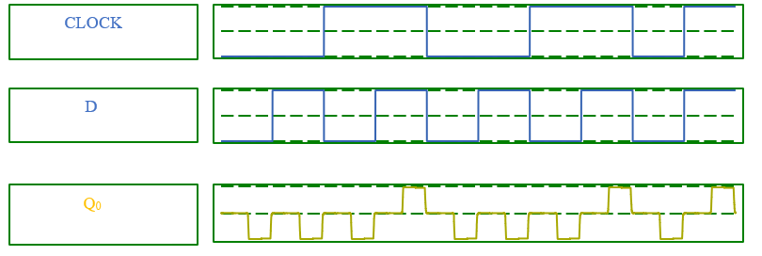
SIMULATION

Slide 17
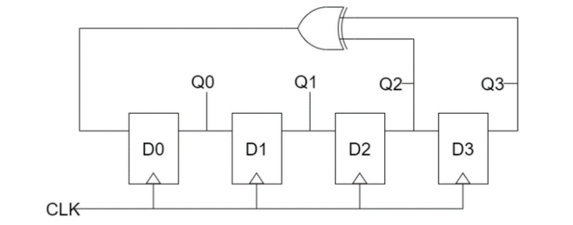
Block Diagram

Slide 18
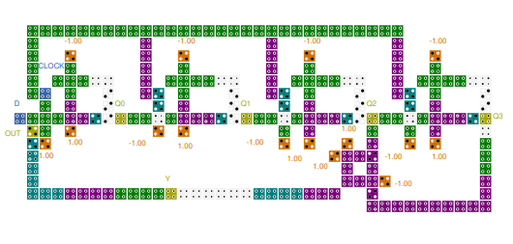
LINEAR FEEDBACK SHIFT REGISTER

Slide 19
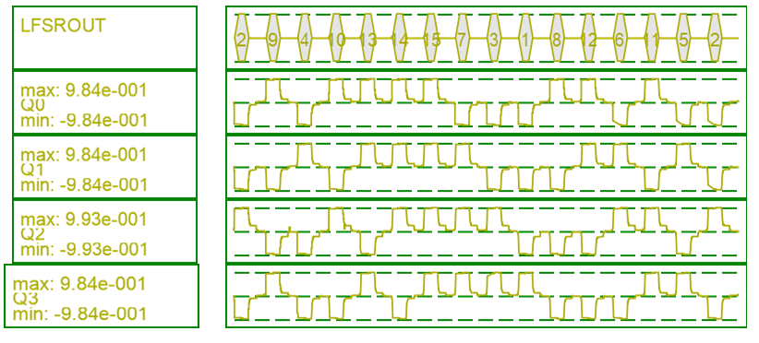
SIMULATION

Slide 20
RESULTS AND DISCUSSIONS
Shift Number | State of Shift Register | PN Sequence
0 1 2 3 4 5 6 7 8 9 10 11 12 13 14 15 | 0010 1001 0100 1010 1101 1110 1111 0111 0011 0001 1000 1100 0110 1011 0101 0010 | 0 1 0 0 1 0 1 1 1 1 0 0 0 1 1 0

Slide 21
PROPERTIES OF PN SEQUENCE
Balance Property:
Number of 1’s: 8
Number of 0’s: 7
Number of 1’s > Number of 0’s
Hence, Balance Property is satisfied.
Run Property:
Total number of runs: 2^{(m-1)} =2⁽⁴⁻¹⁾ =8
Number of runs with length of 1-bit = ½ (Total number of runs) =4
Number of runs with length of 2-bit = ¼ (Total number of runs) =2
Number of runs with length of 3-bit = 1/8(Total number of runs) =1
Hence, Run Property is satisfied.

Slide 22
Correlation Property:
PN Sequence: 0 1 0 0 1 0 1 1 1 1 0 0 0 1 1
Shifted Sequence:1 0 1 0 0 1 0 1 1 1 1 0 0 0 1
D D D A D D D A A A D A A D A
D- Disagreed
A-Agreed
D’s > A’s
Hence, Correlation Property is satisfied.

Slide 23
POWER DISSIPATION ANALYSIS
Three basic energy tunneling levels are used to evaluate the dissipated power
The proposed quantum LFSR comprises 216 cells with an area of 0.23µm^2 and the total power dissipation is 0.31442 eV, 0.41729 eV, and 0.54389 eV at different standard tunneling energy levels. The power parameters are analyzed using QCA Pro Tool.

Slide 24
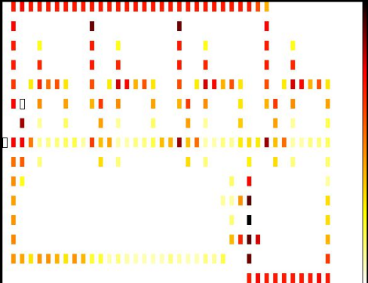
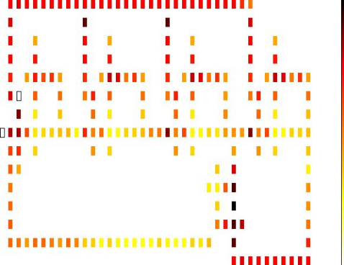
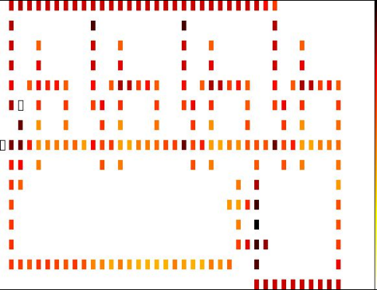
Energy dissipation maps of the proposed QCA-based RNG at (a)0.5E_{k} , (b)1E_{k} , (c)1.5E_{k} at 2K Temperature.
0.5 E_{k}
1.0 E_{k}
1.5 E_{k}

Slide 25
Various Parameters Calculated by QCA Pro Tool
Parameters | 0.5Ek | 1Ek | 1.5Ek
Max Kink Energy | 0.00148eV | 0.00148eV | 0.00148eV
Max Energy Dissipation of Circuit | 0.61287eV | 0.66782eV | 0.75373eV
Avg Energy Dissipation of Circuit | 0.31442eV | 0.41729eV | 0.54389eV
Max Energy Dissipation among all Cells | 0.00915eV | 0.00908eV | 0.00902eV
Min Energy Dissipation of Circuit | 0.06814eV | 0.20424eV | 0.36287eV
Avg Leakage Energy Dissipation | 0.06940eV | 0.20659eV | 0.36576eV
Avg Switching Energy Dissipation | 0.24502eV | 0.21069eV | 0.17813eV
Total Power Dissipation | 0.31442 eV | 0.41729 eV | 0.54389 eV

Slide 26
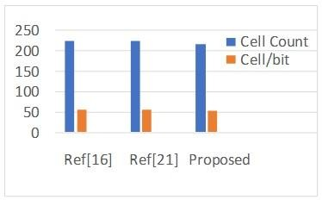
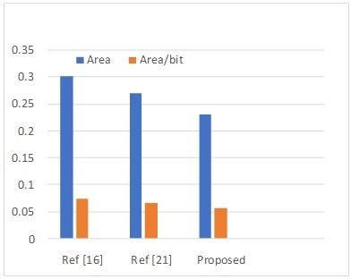
Performance comparison of Proposed and Existing works
LFSR | BIT | CELL COUNT | CELL/ BIT | AREA(µm²) | AREA /BIT(µm²)
REF[16] | 4 | 226 | 56.5 | 0.30 | 0.075
REF[21] | 4 | 226 | 56.5 | 0.27 | 0.0675
PROPOSED | 4 | 216 | 54 | 0.23 | 0.0575
Cell count for various proposed methods
Area and area per bit for various proposed methods

Slide 27
TIME LINE ACTIVITY
S.NO
REVIEW
EXPECTED STATUS
S.NO
REVIEW
EXPECTED STATUS
S.NO | REVIEW | EXPECTED STATUS
1 | 0th review(17/2/23) | Problem identification and Literature Survey
2 | 1st review(7/3/23) | Implementing LFSR using QCA
3 | 2nd review(21/4/23) | Different Parameters and Performance Analysis of the Implemented design
4 | Final review(19/5/23) | Demo and Report

Slide 28
CONCLUSION
The proposed RNG has been developed to optimize both power dissipation and space constraints.
The proposed LFSR design implementation is seen to drastically lower the cell count when compared to previously published designs in the literature.
The size of the proposed LFSR is over 8% smaller than that of the literature, and the cell count is approximately 4.5% lower. This technique also considerably decreases area and power.
Hence, the proposed approach provides much scope for developing power-efficient secured RNG implementations. It could be used to construct intricate circuits for secure communication for various blocks for encryption and decryption

Slide 29
FUTURE SCOPE
QRNGs could be integrated into existing encryption algorithms, digital signatures, and key generation, improving the security of these systems. QRNGs also have the potential for use in post-quantum cryptography, which aims to develop cryptographic protocols that are resistant to attacks from quantum computers. Overall, the integration of QRNGs into cryptographic systems has vast potential for improving the security of sensitive information.

Slide 30
REFERENCES
[1] Marsaglia, G. (2003). Random number generators. Journal of Modern Applied Statistical Methods, 2(1), 2.
[2] Durga, R. S., Rashmika, C. K., Madhumitha, O. N., Suvetha, D. G., Tanmai, B., & Mohankumar, N. (2020, August). Design and synthesis of LFSR based random number generator. In 2020 Third International Conference on Smart Systems and Inventive Technology (ICSSIT) (pp. 438- 442). IEEE
[3] Oommen, R., George, M. K., & Joseph, S. (2018, December). Study and analysis of various LFSR architectures. In 2018 International Conference on Circuits and Systems in Digital Enterprise Technology (ICCSDET) (pp. 1-6). IEEE
[4] Purkayastha, T., De, D., & Das, K. (2016). A novel pseudo random number generator based cryptographic architecture using quantum-dot cellular automata. Microprocessors and Microsystems, 45, 32-44.
[5] Fazili, M. M., Shah, M. F., Naz, S. F., & Shah, A. P. (2022). Next generation QCA technology based true random number generator for cryptographic applications. Microelectronics Journal, 126, 105502.
[6] Naz, S. F., Riyaz, S., & Sharma, V. K. (2022). A Review of QCA Nanotechnology as an Alternate to CMOS. Current Nanoscience, 18(1), 18-30.
[7] Kavitha, S. S., & Kaulgud, N. (2017, December). Quantum dot cellular automata (QCA) design for the realization of basic logic gates. In 2017 International Conference on Electrical, Electronics, Communication, Computer, and Optimization Techniques (ICEECCOT) (pp. 314-317). IEEE.
[8] Reis, D. A., Campos, C. A. T., Soares, T. R. B., Neto, O. P. V., & Torres, F. S. (2016, May). A methodology for standard cell design for QCA. In 2016 IEEE International Symposium on Circuits and Systems (ISCAS) (pp. 2114-2117). IEEE.
[9] Ahmed, S., Naz, S. F., Sharma, S., & Ko, S. B. (2021). Design of quantum‐dot cellular automata‐based communication system using modular N‐bit binary to gray and gray to binary converters. International Journal of Communication Systems, 34(4), e4702.
[10]Hashemi, S., & Navi, K. (2012). New robust QCA D flip flop and memory structures. Microelectronics Journal, 43(12), 929-940.
[11] Goswami, M., Kumar, B., Tibrewal, H., & Mazumdar, S. (2014, January). Efficient realization of digital logic circuit using QCA multiplexer. In 2014 2nd International Conference on Business and Information Management (ICBIM) (pp. 165-170). IEEE.
[12] Binaei, R., & Gholami, M. (2019). Design of multiplexer-based D flipflop with set and reset ability in quantum dot cellular automata nanotechnology. International Journal of Theoretical Physics, 58(3), 687- 699.

Slide 31
[13] Kalyan, B. S., & Singh, B. (2020). Performance analysis of quantum dot cellular automata (QCA) based linear feedback shift register (LFSR). International Journal of Computing and Digital Systems, 9(03).
[14] Abutaleb, M. M. (2018). A novel true random number generator based on QCA nanocomputing. Nano Communication Networks, 17, 14-20.
[15] Rezaei, A., &Saharkhiz, H. (2016). Design of low power random number generators for quantum-dot cellular automata. International Journal of Nano Dimension, 7(4), 308
. [16] Beigh, M. R., & Mustafa, M. (2015). Novel linear feedback shift register design in quantum-dot cellular automata. Indian Journal of Pure & Applied Physics (IJPAP), 52(3), 203-209.
[17]Amirzadeh, Z., &Gholami, M. (2020). Analysis and design of the pseudo-random bit generator in the technology of quantum-dot cellular automata. International Journal of Theoretical Physics, 59(1), 29-48
[18] Srivastava, S., Asthana, A., Bhanja, S., & Sarkar, S. (2011, May). QCAPro-an error-power estimation tool for QCA circuit design. In 2011 IEEE international symposium of circuits and systems (ISCAS) (pp. 2377- 2380). IEEE.
[19] Ganesh, E. N., Kishore, L., &Rangachar, M. (2008). Implementation of Quantum cellular automata combinational and sequential circuits using Majority logic reduction method. International Journal of Nanotechnology and Applications, 2(1), 89-106.
[20] Yaqoob, S., Ahmed, S., Naz, S. F., Bashir, S., & Sharma, S. (2021). Design of efficient N‐bit shift register using optimized D flip flop in quantum dot cellular automata technology. IET quantum communication, 2(2), 32-41.
[21] Sadhu, A., Das, K., De, D., & Kanjilal, M. R. (2022). Low power design methodology in quantum-dot cellular automata. Computers & Electrical Engineering, 97, 107638.
[22] Kim, H. I., & Jeon, J. C. (2022). Quantum LFSR Structure for Random Number Generation Using QCA Multilayered Shift Register for Cryptographic Purposes. Sensors, 22(9), 3541
[23] Timler, J., & Lent, C. S. (2002). Power gain and dissipation in quantum-dot cellular automata. journal of applied physics, 91(2), 823-831
[24] Senthilnathan, S., & Kumaravel, S. (2020). Power-efficient implementation of pseudo-random number generator using quantum dot cellular automata-based D flip flop. Computers & Electrical Engineering, 85, 106658.

Slide 32
Thank You

